Slide 1
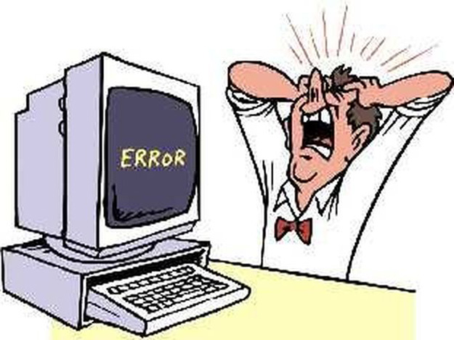
CS 118: Data Link, Error
Recovery Slides, Lecture 5
George Varghese

Slide 2

PROMPT: Give me an everyday analogy to a network protocol
Sure! Here’s another analogy:
Think of a network protocol as the process of ordering food at a restaurant
TODAY WE STUDY OUR FIRST NON-TRIVIAL EXAMPLE OF A PROTOCOL

Slide 3
Follow RFC
Follow RFC
SENDER PROTOCOL
RECEIVER PROTOCOL
Protocol Messages
Interface to Lower Level Proiocol
RFCs are informal English specifications of
How Internet Protocols should work

Slide 4
Copy File F at S
to File F at D
S
R1
R2
D
User Interface
Write (m) to connection queue
Read (m)
Transport (TCP)
Interface
^{F}6-8 | ^{F}2-5 | F₁
Send (segment) to D
Receive (segment)
Routing (IP) Interface
S
R1
R2
D
other paths?
Send (packet)
Receive (packet)
Data Link Interface
R1
R2
Send (bit)
Receive (bit)
Physical Layer Interface
Each layer provides a service to the layer above it

Slide 5
Data Link Sublayers
Point−to−point Links (2 nodes)
(e.g., HDLC, Frame Relay)
Broadcast Links (>= 2 nodes)
(e.g., Ethernet, Token Ring)
Frames
Frames
ERROR RECOVERY
(OPTIONAL)
MULTIPLEXING
MEDIA ACCESS
ERROR DETECTION
ERROR DETECTION
FRAMING
FRAMING
Bits
Bits
QUASI-RELIABLE 1 HOP FRAME PIPE

Slide 6
Why error recovery at Data Link?
Used later: Protocols like TCP and Project 1 use same ideas. When we get to TCP, will only study differences.
Still used at Data Link: existing protocols (e.g., HDLC Fiber Channel ) still do error recovery at Data Link.
Non-trivial protocol: Our first example of the problems caused by varying message delay and errors (frame loss, crashes)
Technology seesaw: Hop-by-hop becoming popular again to reduce latency. Wheel of time!

Slide 7
Correctness Specification
a,b,c,d
a,b,c,d
SENDER
RECEIVER
Packets given to the sending Data Link must be delivered to receiver without duplication, loss, or mis-ordering

Slide 8
Assumptions
Assumes error detection: Assumes undetected error rate small enough to be ignored
Loss as well as errors: whole frames can be lost in a way not detected by error detection
FIFO: Physical layer is FIFO
Arbitrary Delay: Delay on links is arbitrary and can vary from frame to frame.

Slide 9
Assumptions
Assumes error detection: Assumes undetected error rate small enough to be ignored
Loss as well as errors: whole frames can be lost in a way not detected by error detection
FIFO: Physical layer is FIFO
Arbitrary Delay: Delay on links is arbitrary and can vary from frame to frame.

Slide 10
Protocol Plays to motivate Stop and Wait Protocol
Node S
a, b, c
Node R
a
b
Time
b
Loss
→ Must retransmit
Node S
a, b, c
Node R
a
Ret
a
a a
ack
Duplication
→ Must defend against early retransmits

Slide 11
More Protocol Plays
Node S
Node R
a, a,
a a ack a
Ret
a
Reject
Time
Reject Reject
a
Livelock
→ Need sequence numbers
Node S
a, b
0
Node R
0
a,0
Ret
a,0
1 a
Reject
Reject Reject
ack
a,0
a,0
Livelock
→ Must ack even duplicates

Slide 12
Final Protocol Play
Node S
a, b, c
0
Node R
0
Time
a,0
Ret
a,0 ack
ack
1 a
Reject
b,1
c,2
Loss
→ Must number acks

Slide 13
Sketch of Final Protocol
Node S
Node R
0
D,0
0
1
A,1
1
Time
D,1
D,1
A,2
D,2
D,2
A,3
2
2
3
3

Slide 14
Going deeper
Correctness: How do we we show it works in all cases (infinite sequence of executions): invariants
Sequence Number: Do we need an infinite number of bits? Heck, no
Performance: send only one at a time. Bad over satellites. Can do better → sliding window.
Initialization: How do we get started and synchronize sequence numbers in face of crashes

Slide 15
Code (buggy) of Stop and Wait
1) Accept a new packet if available from higher layer and store it in buffer B
2). Transmit a frame Send (SN, B)
3). If error-free (ACK, R) frame received and R != SN then
SN = R
Go to Step 1
Else if the previous condition does not occur after T sec
Go to Step 2
When an error free data frame (S, D) is received
On receipt:
If S = RN then
Pass D to higher layer
RN = RN + 1;
Send (ACK, RN)
------------Sender Code----------------------------
Sender keeps state variable SN, initially 0 and repeats following loop
Receiver Code ---------------------------------------
Receiver keeps state variable RN, initially 0

Slide 16
Correct Code of Stop and Wait
1) Accept a new packet if available from higher layer and store it in buffer B
2). Transmit a frame Send (SN, B)
3). If error-free (ACK, R) frame received and R != SN then
SN = R
Go to Step 1
Else if the previous condition does not occur after T sec
Go to Step 2
When an error free data frame (S, D) is received
On receipt:
If S = RN then
Pass D to higher layer
RN = RN + 1;
Send (ACK, RN) // Send ack unconditionally!
------------Sender Code----------------------------
Sender keeps state variable SN, initially 0 and repeats following loop
Receiver Code ---------------------------------------
Receiver keeps state variable RN, initially 0

Slide 17
Correctness Observations
Node S
Node R
0
D,0
0
1
A,1
1
Time
D,1
D,1
A,2
D,2
D,2
A,3
2
2
3
3
When sender first gets to N, no frames with N or acks with N+1 and receiver is at N
When receiver first receives frame N, entire system only contains number N→ only two numbers in system

Slide 18
How to reason: from time-space to Global States

Slide 19
D(0)
0
0
Send frame 0
D(0)
D(0)
0
0
Retransmit early
D(0)
0
1
A(1)
Receive D(0); Send Ack
D(1)
D(0)
1
1
Receive ack; send new frame

Slide 20
Retain only the numbers
0
0
0
0
0
0
0
Band 2
Band 1
0
0
1
1
Band 1
1
0
1
1

Slide 21
Band Invariant
When sender first gets to N, no frames with N or acks with N+1 and receiver is at N
When receiver first receives frame N, entire system only contains number N→ only two numbers in system → So what?

Slide 22
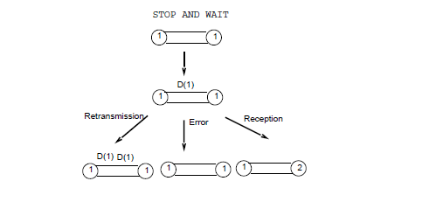
Prove Invariant by checking a small number of State Transitions
3 other cases: Receive Ack, Send Ack, and Send new frame
Just need to show that invariant is preserved by these 6 protocol actions/state transitions.

Slide 23
Case: sender gets new ack
?
N-1
?
N
N-1
N-1
N
N
N
N
N
N-1
N
N
N
N
N
Which preserves invariant

Slide 24
Code of Alternating Bit
1) Accept a new packet if available from higher layer and store it in buffer B
2). Transmit a frame Send (SN, B)
3). If error-free (ACK, R) frame received and R != SN then
SN = R
Go to Step 1
Else if the previous condition does not occur after T
Go to Step 2
When an error free data frame (S, D) is received
On receipt:
If S = RN then
Pass D to higher layer
RN = ~ RN ; //flip bit!
Deliver data m to client.
Send (ACK, RN) // Send ack unconditionally!
------------Sender Code----------------------------
Sender keeps state bit SN, initially 0 and repeats following loop
Receiver Code ---------------------------------------
Receiver keeps state bit RN, initially 0

Slide 25
So far we have shown
Correctness: based on band invariant
Sequence Number: one bit suffices
Performance: send only one at a time. Bad over satellites or any link were the bandwidth-delay product is large. So now we see how to do better
Initialization: Coming up after performance

Slide 26
General Performance Measures
Throughput: jobs completed per second. System owners want to maximize this.
Latency: worst-case time to complete a job. Users want to minimize.
Factory: Each pipeline stage = 1 second
Throughput = 1 , Latency = 4
Bank: Each teller = 1 second
Throughput = 3, Latency = 1

Slide 27
Network Specific Measures
1-way Propagation Delay: Time for transmitted bit to reach receiver. Contrast to transmission rate.
Pipe Size: Transmission Rate * Round-trip Propagation Delay. Need to pipeline if pipe size is large. Alternating bit does not. Sometimes called the bandwidth-delay product
Sender
Receiver
Bit 1 of Frame
1-way Prop Delay
1/Transmission Rate
Last bit of Frame

Slide 28
Stop and wait on Satellite Link
1-way Propagation Delay: 250 msec
Transmission speed: 100 kbit/sec
Frame size: 1000 bits.
What is throughput? 2000 bits per second, which is 2% of a 100,000 bit per second link.
Sender
Receiver
10 msec =
1000/100K
Frame
250 msec
Idle Time!
Ack
250 msec

Slide 29

If you don’t want to be fired for using 2% of capacity . . . .
you got to send more frames before the ack for first frame arrives
How? Using Sliding Window Protocols

Slide 30
Sliding Window Protocols
Window: Sender can send a window of outstanding frames before getting any acks. Lower window edge L, can send up to L + w - 1.
Receiver numbers: receiver has a receive sequence number R, next number it expects. L and R are initially 0.
Sender Code: Retransmits all frames in current window until it gets an ack. Ack numbered r implicitly acknowledges all numbers < r.
Two variants: receiver accepts frames in order only (go-back-N) or buffers out-of-order frames (selective reject}

Slide 31
GO BACK 3
SELECTIVE REJECT
0,2
D(0)
A(1)
D(1)
1,3
0,2
0
1
0
1
D(0)
A(1)
D(1)
1,3
WINDOW SLIDES
WINDOW SLIDES
D(2)
D(3)
REJECT
D(2)
D(3)
BUFFER
REJECT
BUFFER
TIMER
EXPIRES _{D(1)}
D(2)
D(3)
A(4)
4,6
Ack with list
of numbers
Received out
Of order
A(1; 2, 3)
TIMER
EXPIRES _{D(1)}
WINDOW SLIDES
A(4)
WINDOW SLIDES
4,6

Slide 32
Go Back N Code
Send (s,m) // send data message m with number s
The sender can send this frame if:
m corresponds to s-th data item
given to sender by client AND
L <= s <= L + w - 1 // in allowed send window
Receive(r, Ack) // receive an ack number r
On receipt:
L := r // slide lower window edge to ack number
Receive(s, m) // receive data message m with number s
On receipt:
If s = R then
R := s + 1
Deliver data m to client.
Send(r, Ack) // send ack with number r
// receivers typically send acks in response to data
// messages but our code can send acks anytime
r must equal R
------------Sender Code----------------------------
Sender keeps state variable L, initially 0
Receiver Code ---------------------------------------
Receiver keeps state variable R, initially 0

Slide 33
GO BACK 3 EXAMPLE WITH SOME VARIABLE VALUES
Sender
Receiver
0,2
0
1
D(0)
A(1)
D(1)
1,3
R = 1
WINDOW SLIDES
D(2)
D(3)
REJECT
REJECT
TIMER
EXPIRES _{D(1)}
D(2)
D(3)
A(4)
4,6
2
s = 2
3
4
WINDOW SLIDES
r = 4
L = 4
L + 3 - 1

Slide 34
Selective Reject Sender code
Sender keeps a lower window edge L initially 0 but also an array with a bit set for all numbers acked so far. Initially, all bits are clear. In practice, we implement this array by a bitmap of size w which we shift
Send (s, m) // send data message m with number s
The sender can send this frame if:
m corresponds to s-th data item
given to sender by client AND
L <= s <= L + w - 1 AND
s has not been acked // new for selective reject
Receive(r, List Ack) // receive an ack number r with List
// of received numbers > r
On receipt:
L := r // slide lower window edge to ack number
Mark numbers in List as acked at sender

Slide 35
Selective Reject Receiver Code
Receiver keeps a receiver number R initially 0 but also an array with a bit set for all numbers received so far. Initially, all bits are clear. In practice, we implement this array again by a bitmap of size w which we shift.
In addition to the bitmap, we have a buffer for each number where we can store out of order messages
Receive ( s, m) // receive data message m with number s
On receipt:
If s >= R then
Mark s as acked and Buffer m
While R acked do
Deliver data message at position R
R := R + 1
Send (r, List Ack) // send ack with number r and List
// of received numbers > r
r must equal R
List contains received numbers > R
1 0 0 0 0 0
1 0 1 0 0 0

Slide 36
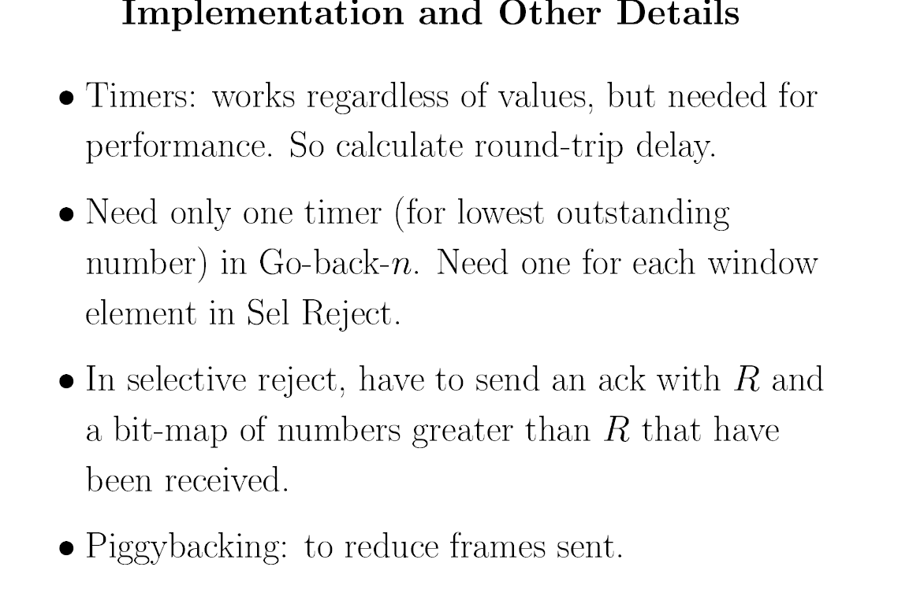

Slide 37
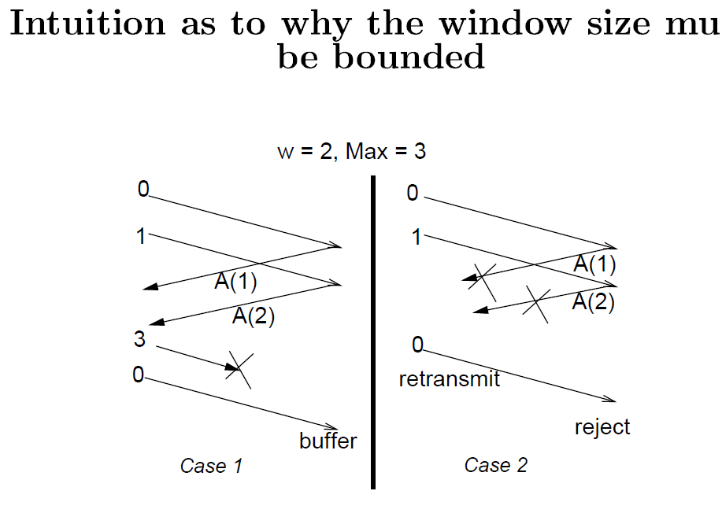
How big should the sequence number space be?
Alternating bit: Modulus is 2 (just one bit)
Go back W: Need a Modulus of W+1
Selective Reject: Need a modulus of 2 W

Slide 38
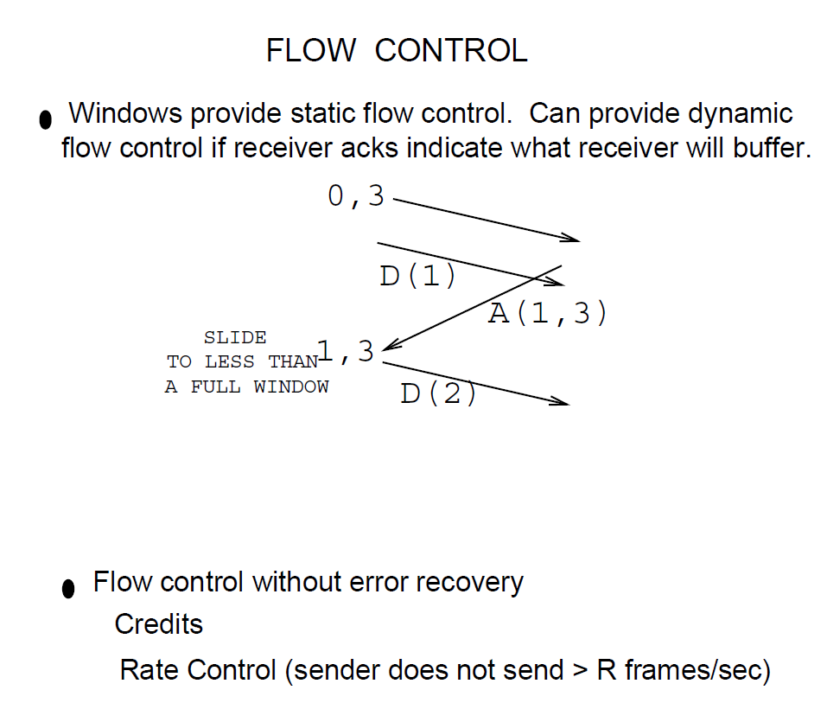

Slide 39
INITIALIZING LINK PROTOCOLS
(in the face of link and node crashes)
Sender
(crash)
Receiver
RESTART
RN=0
ACK
SN=0
D(0)
1
A(1)
EXAMPLE: SETM = RESTART in HDLC

Slide 40
How naïve restarts can fail
A
B
A
B
R
R(reset)
R
RA
RA
D(0)
D(0)
RA
R
A(1)
A(1)
D(0)
NODE CRASH
Can prove that there is no reliable initialization protocol if we assume no non-volatile memory that survives crashes, the protocol is deterministic, and message can stay on wire indefinitely
So? Do we give up? No change assumptions

Slide 41
How to design a reliable initialization protocol
Change one of the assumptions in impossibility theorem:
No memory after a crash: Can do correctly if sender keeps even one bit that can survive a crash
Determinism: Can send restart messages with random numbers and only send data when random numbers are acked. High probability only
Message lifetimes: If no message can live on a link for more than T seconds, simply wait T seconds after a crash for all old messages to die out

Slide 42
Protocol Design Lessons
Start simple: Start with simple protocols like Stop and Wait. Optimize later based on invariants
Minimal Specification: Understand what parts of protocol need to be specified for correctness. Some parts can be left to implementers to optimize
Be an engineer: Our Impossibility results tell us what we need to change to get our job done, not just what we can't do.
Next time: Media Access Control and LANs

Slide 43

EPILOG: POINCARE ON CREATIVITY
“I left Caen, where I was living, to go on a geological . . . travel made me forget my mathematical work . . . we entered an omnibus . .. At the moment when I put my foot on the step, the idea came to me, without anything in my former thoughts seeming to have paved the way for it, that the transformations . . [for] Fuchsian functions were identical with those of non-Euclidean geometry. I did not verify the idea . . but I felt a perfect certainty. On my return to Caen, I verified the result at my leisure.”
― Henri Poincaré.

